Slide 1
Medical Microrobots
Ali Berrada

Slide 2
Surgical Approaches
Traditional Surgery
Minimally Invasive Surgery
Today
Robot assisted surgery
Microrobotic Surgery
Notes:
Minimally invasive procedures are linked with a variety of patient-oriented benefits ranging from
reduction of recovery time, medical complications, infection risks, and postoperative pain to increased
quality of care, including preventative care. The first is the success of Intuitive Surgical’s da Vinci: a robotic, minimally invasive surgical system.
The second is the steadily increasing worldwide adoption of capsule endoscopy for gastrointestinal
(GI) diagnosis.

Slide 3
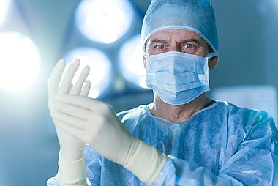
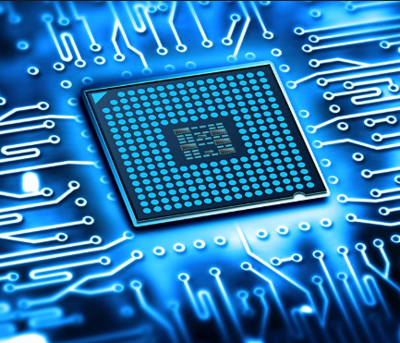
Motivation
Notes:
The idea is not about changing the surgeon but about improving the technology.
a surgeon’s most important skill is cognitive ability, whereas technical skills required for precision and dexterity can often be delegated to appropriate technology.
MIS is the trend and expecting to grow even more. It is applied to a wide range of surgical procedures (prostate, liver, heart). It has market value of multi billion USD.
The future is to become smaller, autonmated and more precise.

Slide 4
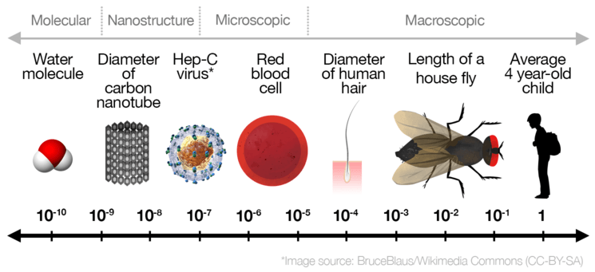
Scale

Slide 5
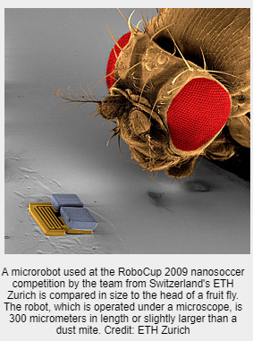
Medical Microrobots
Miniature robots of size less than 1 mm.
Potential to perform tasks that are currently difficult/impossible.
Help in developing therapies not yet conceived.

Slide 6
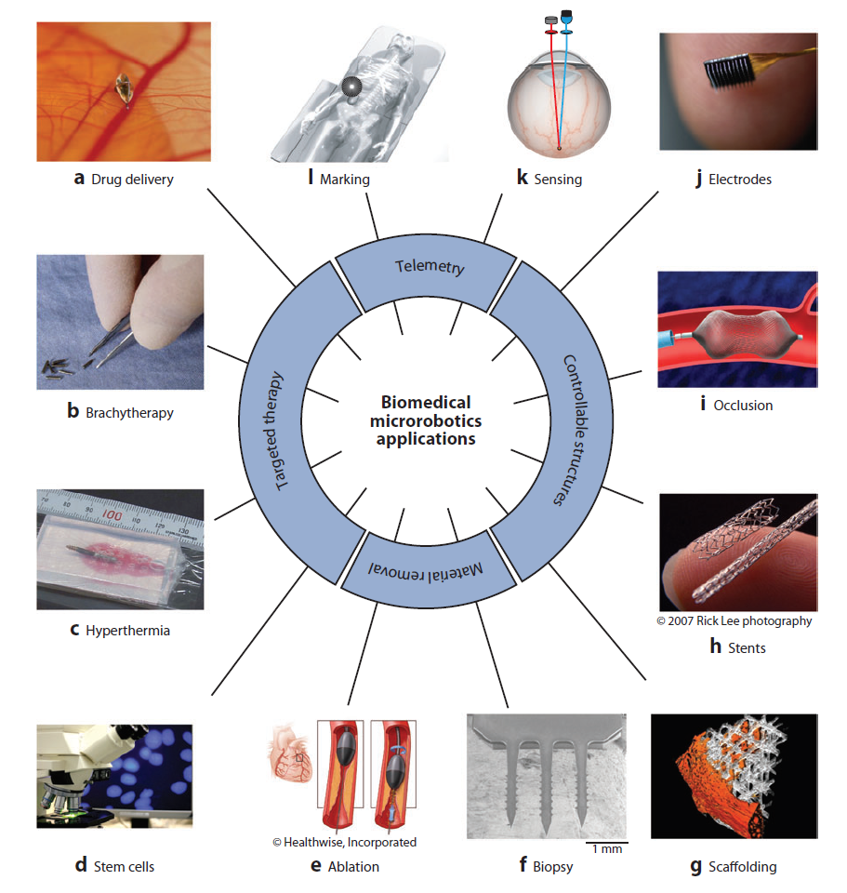
Applications
Notes:
1. Targeted therapy.
Microrobots can be used for the localized delivery of chemical and
biological substances, as well as various forms of energy. The following are some therapeutic uses
for microrobots:
Targeted drug delivery can be used to simultaneously increase the concentration of drug
in a region of interest and reduce the risk of side effects in the rest of the body. The term
targeted drug delivery is sometimes used to refer to therapies that target specific cells or
genes, but we use the term here to refer to the targeting of a specific location in the body.
Brachytherapy is the placement of a radioactive source, sometimes referred to as a radioactive
seed, near unwanted cells such as a tumor (26). The radiated energy results in death of the
cells close to the radioactive source.
Hyperthermia and thermoablation refer to the local delivery of heat energy to destroy
unwanted cells (27). Hyperthermia involves moderately raising temperature for extended
periods of time, typically to the range of 40–45◦C, to improve the effectiveness of other
therapies; thermoablation involves raising the temperature to the point of cell death,
which is typically above 50◦C (28). The most promising methods for wireless heat delivery
include high-frequency magnetic fields (27) and ultrasonic-resonating mechanical
structures.
Stem cells hold enormous potential for future therapies (e.g., regeneration of lost hearing
and sight). It is not yet clear how differentiated stem cells will be implanted and fostered in
vivo in a clinical setting. This may be a task well suited to microrobotic assistance.
2. Material removal. Microrobots can be used to remove material by mechanical means. If
the microrobot is relatively large, it may be possible to design specialized tools to accomplish the
task. However, for smaller microrobots, the microrobot itself will be the tool. The following are
two methods of material removal that can be performed by microrobots:
Ablation is the removal of material from the surface of an object. In its simplest form, this
is accomplished by scraping. As we will show, microrobots may be particularly well suited
for utilizing rotary motion to perform ablation tasks, which would be useful, for example, in
the removal of fatty deposits from the internal walls of blood vessels. Another possibility is
ultrasound ablation, in which a microrobot uses a resonating mechanical structure to emit
ultrasonic pressure waves to destroy an object such as a kidney stone.
Biopsy/excision can also be performed by microrobots. In the simplest case, the microrobot
retrieves a tissue sample and is removed from the body, and the analysis is conducted ex
vivo. If biopsy or excision is combined with remote-sensing technology, the sample can be
analyzed in situ.
3. Controllable structures. Microrobots can act as simple static structures whose positions
are controllable:
Scaffolds act as cell support frames on which nerves can be regenerated, artificial organs
developed, and blood vessels regrown. The microrobot itself can act as the scaffold, or the
microrobot can deploy microscopic building blocks that act as scaffolding (29).
Stents are structures that are used to keep passageways open. A typical example is the use of
a stent to keep blood flowing though a clogged vessel. The microrobot itself would serve as
the stent and would navigate and deploy in the location of interest.
Occlusions can be introduced to intentionally block a passageway, either temporarily or
permanently. Microrobots can function as occlusions, for example, to clog a blood vessel
that nourishes a tumor.
Implants/electrodes can be introduced by microrobots. A microrobot can act as a temporary
or permanent implant, such as an electrode for brain stimulation.The electrode may operate
wirelessly, or a wirelessly guided microrobot may tow a fine wire.
4. Telemetry. Microrobots can be used to transmit, from a specific location, information
that would otherwise be difficult or impossible to obtain. This information can be transduced
using a variety of methods (e.g., radio, visible light, ultrasound). Telemetry applications include
remote sensing and marking:
Microrobots can perform remote sensing. For example, microrobots can transmit the time
history of a physical signal of interest (e.g., oxygen concentration) or transmit a simple binary
signal upon detecting the presence of an analyte of interest (e.g., cancer, blood).
Marking and transmitting the microrobot’s position to the outside world can prove useful.
It can be used for microrobot localization, and when combined with remote sensing, it can
be used to localize unknown internal phenomena (e.g., bleeding).Marking requires not only
sensing and transmitting but also the ability of the microrobot to maintain its location at
the site.

Slide 7
Application Areas
Circulatory system:
consists of the heart and the vessels used to carry blood around the body.
targeted drug delivery, destroying blood clots, administering, therapy for aneurysms, etc.
Central nervous system:
consists of the brain, the spinal cord, and the cerebrospinal fluid in which both the brain and spine are bathed
brain’s delicate structures demand appropriate caution in any procedure.
cancer treatment.
Urinary system and prostate:
includes the kidneys, urinary bladder, ureters, and urethra.
destroy kidney stones, treatment of prostate cancer
Notes:
Once equipped with some basic functionalities and miniaturized to a size of a few millimeters or
less, microrobots have the potential to perform medical procedures throughout the body.
Circulatory system:
Nearly every site of the body can be accessed by blood, so the circulatory system is arguably the
most important application area for wireless microrobots. Some of themost promising applications
for microrobots in the circulatory system include performing targeted drug delivery, removing
plaque (rotational atherectomy), destroying blood clots (thrombolysis), acting as stents tomaintain
blood flow, acting as occlusions to intentionally starve a region of nutrition, and administering
therapy for aneurysms. Microrobots could also carry electrodes for electrophysiology.
Central nervous system:
Microrobots have the potential to dramatically affect cancer treatment in the central nervous
system. Neural prostheses and deep-brain stimulation are other promising applications for microrobots
that are wirelessly guided to hard-to-reach sites. The microrobots may even remain as
implants. The brain’s delicate structures demand appropriate caution in any procedure, and the
impact of minimally invasive microrobotic procedures could be profound.
Urinary system:
Microrobots have the potential to improve the treatment of kidney stones (nephrolithotomy).
Recently, a study was performed on the factors that affect blood loss during percutaneous
nephrolithotomy (PCNL) (48). Bleeding during PCNL results from injury to the renal vessels
and is the most common complication of percutaneous renal surgery. Optimal access to the stone
site has a direct effect on the outcome of the procedure. Multiple punctures of the kidney and perforations
of the manifold that leads to the ureter (i.e., the renal pelvis) are associated with greater
blood loss. There are also complications associated with extracorporeal shock-wave lithotripsy,
including bleeding and infection (49). Edd et al. propose a microrobot that would swim up the
ureter to destroy kidney stones in a process whose potential benefits would include less overall
harm to the kidney and increased choice over the mechanism of stone destruction (50). It is also
possible that the tethered and implanted MEMS devices designed for use in urology (51) could
be incorporated into a wireless microrobot.
Another potential application for microrobots is in the treatment of prostate cancer. The
current clinical techniques for prostate therapy involve needle insertion through the perineum,
during which there is a significant risk of damage to the densely populated nerves nearby. An
alternative approach is to gain access to the prostate through the colon. The distance that the
needle must travel is smaller in this case, and the nerves are avoided, but complex maneuvers must
be performed as opposed to the straight path of the perineum approach, and perforation of the
colon increases the chance of infection. In either case, precise placement of a radioactive seed in
brachytherapy is difficult because the prostate deforms andmoves owing to the force of the needle,
making the released location of the seed different from the planned location. A microrobot could
carry a radioactive seed to the tumor site without causing the bulk deformations in the prostate that
result from a needle. In addition, a microrobot could carry a single radioactive seed to a number
of tumor locations, stopping at each site long enough to give the appropriate dosage. Microrobots
also offer minimally invasive access to the prostate through the urethra. They could improve the
effectiveness of prostate procedures and reduce the chances of nerve damage.
The eye:
The retina is the location of the eye for which microrobots hold the greatest promise because
its health is critical for vision yet it is not easily accessible. Retinal microsurgery requires sensitive
manipulations that are constrained by the limits of human performance (52) and that require
forces below the threshold of human perception (53), making retinal procedures both difficult
and risky. In addition, current vitreoretinal surgical techniques typically require a vitrectomy to gain access to the retina. Microrobots provide an alternative approach to retinal procedures. The
appropriate entry/exit point for a microrobot is the durable pars plana. The microrobot must
navigate to the retina at the posterior pole of the eye. It may be possible to conduct microrobotic
procedures without first performing a vitrectomy because the small size of the microrobot will
mitigate traction on the retina compared with larger tools. Avoiding vitrectomy would reduce the
invasiveness of the procedure and potentially improve the health of the retina after the procedure
by allowing it to maintain a more natural state. Microrobots may also be useful even after a
vitrectomy because they have the potential to perform delicate tasks in a way that mitigates risk
to the retina compared with manual and other robot-assisted techniques. The most promising
applications of intraocular microrobots are therapies for retinal vein occlusions, detached retinas,
and epiretinal membranes, as well as the diagnosis of retinal health. Trocars as large as 23-gauge,
corresponding to a lumen diameter of 0.65 mm, can be used in the pars plana region with only
topical anesthesia and with no suture requirement (54); this size specification serves as a goal for
intraocular microrobots.

Slide 8
Powering
Onboard Power
total deliverable energy scales with volume (not promising).
thin-film batteries may be suitable
Scavenged Power – harvest chemical energy directly from the environment
biofuel cells
exploit glucose and oxygen in blood
Transmitted Power
wirelessly transmit power through the use of magnetic fields.
Notes:
For a technical discussion on the design of wireless microrobots, we must begin with power.With
microrobots, even more so than with traditional robots, we must be acutely aware of the methods
available to store, harvest, and transmit power, and we must acknowledge the strict limitations
that power consideration will put on any practical design. Without addressing power from the
beginning, it is difficult to transition from prototypes to fully miniaturized wireless devices.
Thin-film batteries differ from traditional batteries in that
they are fabricated through the use of semiconductor technologies. These planar fabrication
processes enable the use of arbitrarily shaped batteries with thicknesses less than 50 μm.
A biofuel cell uses living organisms to produce electricity.

Slide 9
Locomotion
Power must be transduced into motion.
The design of the locomotion method must be mindful of the working environment.
Common types:
Helical Propulsion
Traveling-Wave Propulsion

Slide 10
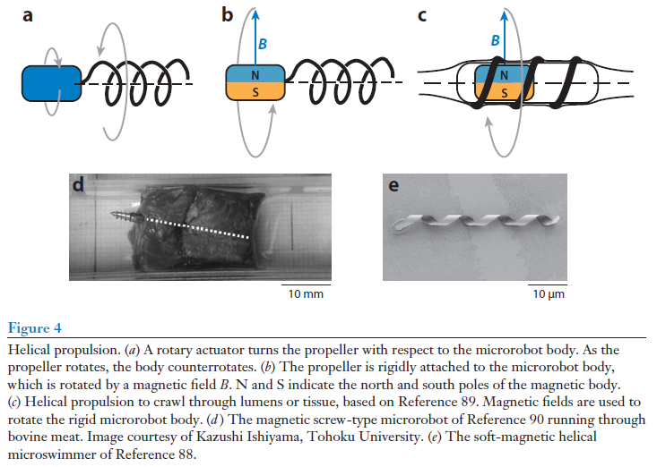
Helical Propulsion

Slide 11
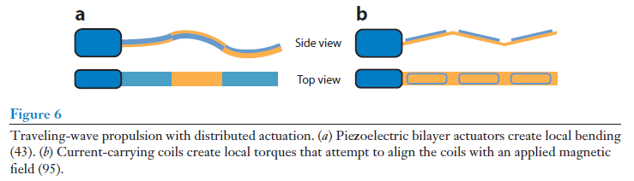
Traveling-Wave Propulsion

Slide 12
Design Challenges
Medical microrobots must be small, reliable and biocompatible.
Carry the necessary tools and subsystems on-board.
Be inserted into, navigated inside and removed from the target site in a “non-invasive” way.

Slide 13
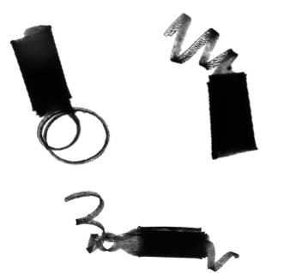
Examples
“Scientists at EPFL and ETHZ have developed a new method for building microrobots that could be used in the body to deliver drugs and perform other medical operations.”
https://www.youtube.com/watch?v=QCsdlgLrF7M
Notes:
Unlike conventional robots, these microrobots are soft, flexible, and motor-less. They are made of a biocompatible hydrogel and magnetic nanoparticles. These nanoparticles have two functions. They give the microrobots their shape during the manufacturing process, and make them move and swim when an electromagnetic field is applied.
Building one of these microrobots involves several steps. First, the nanoparticles are placed inside layers of a biocompatible hydrogel. Then an electromagnetic field is applied to orientate the nanoparticles at different parts of the robot, followed by a polymerization step to “solidify” the hydrogel. After this, the robot is placed in water where it folds in specific ways depending on the orientation of the nanoparticles inside the gel, to form the final overall 3D architecture of the microrobot.
Once the final shape is achieved, an electromagnetic field is used to make the robot swim. Then, when heated, the robot changes shape and “unfolds”. This fabrication approach allowed the researchers to build microrobots that mimic the bacterium that causes African trypanosomiasis, otherwise known as sleeping sickness. This particular bacterium uses a flagellum for propulsion, but hides it away once inside a person’s bloodstream as a survival mechanism.
The researchers tested different microrobot designs to come up with one that imitates this behavior. The prototype robot presented in this work has a bacterium-like flagellum that enables it to swim. When heated with a laser, the flagellum wraps around the robot’s body and is “hidden”.

Slide 14
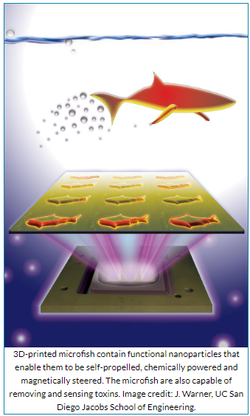
Examples
Notes:
Nanoengineers at the University of California, San Diego used an innovative 3D printing technology they developed to manufacture multipurpose fish-shaped microrobots — called microfish — that swim around efficiently in liquids, are chemically powered by hydrogen peroxide and magnetically controlled. These proof-of-concept synthetic microfish will inspire a new generation of “smart” microrobots that have diverse capabilities such as detoxification, sensing and directed drug delivery, researchers said.

Slide 15
Conclusion
Minimally invasive techniques reduce postoperative pain, hospitalization duration, patient recovery time, infection risks.
Microrobots can serve in several wireless biomedical applications (drug delivery, biopsy sampling, etc.)
Developing this technology requires addressing localization and power issues.
Effective collaboration between medical and robotics experts is an important key for the success of this technology of the future.

Slide 16



Slide 17
References
Nelson, B. J., Kaliakatsos, I. K., & Abbott, J. J. (2010). Microrobots for minimally invasive medicine. Annual review of biomedical engineering, 12, 55-85.
These microscopic fish are 3D-printed to do more than swim.
New remote-controlled microrobots for medical operations.

